Slide 1
The Centre for Ageing Better:
Adaptations and Non-Decent Homes
What’s the Evidence?
November 2019
Millie Brown, Evidence Officer (Housing)
Notes:
This session will look at the evidence of adaptations and our work on non-decent homes that has come as a result including:
The work the Centre for Ageing Better has done in this space
The work we plan to continue doing
The evidence surrounding non-decent homes and its link to adaptations

Slide 2
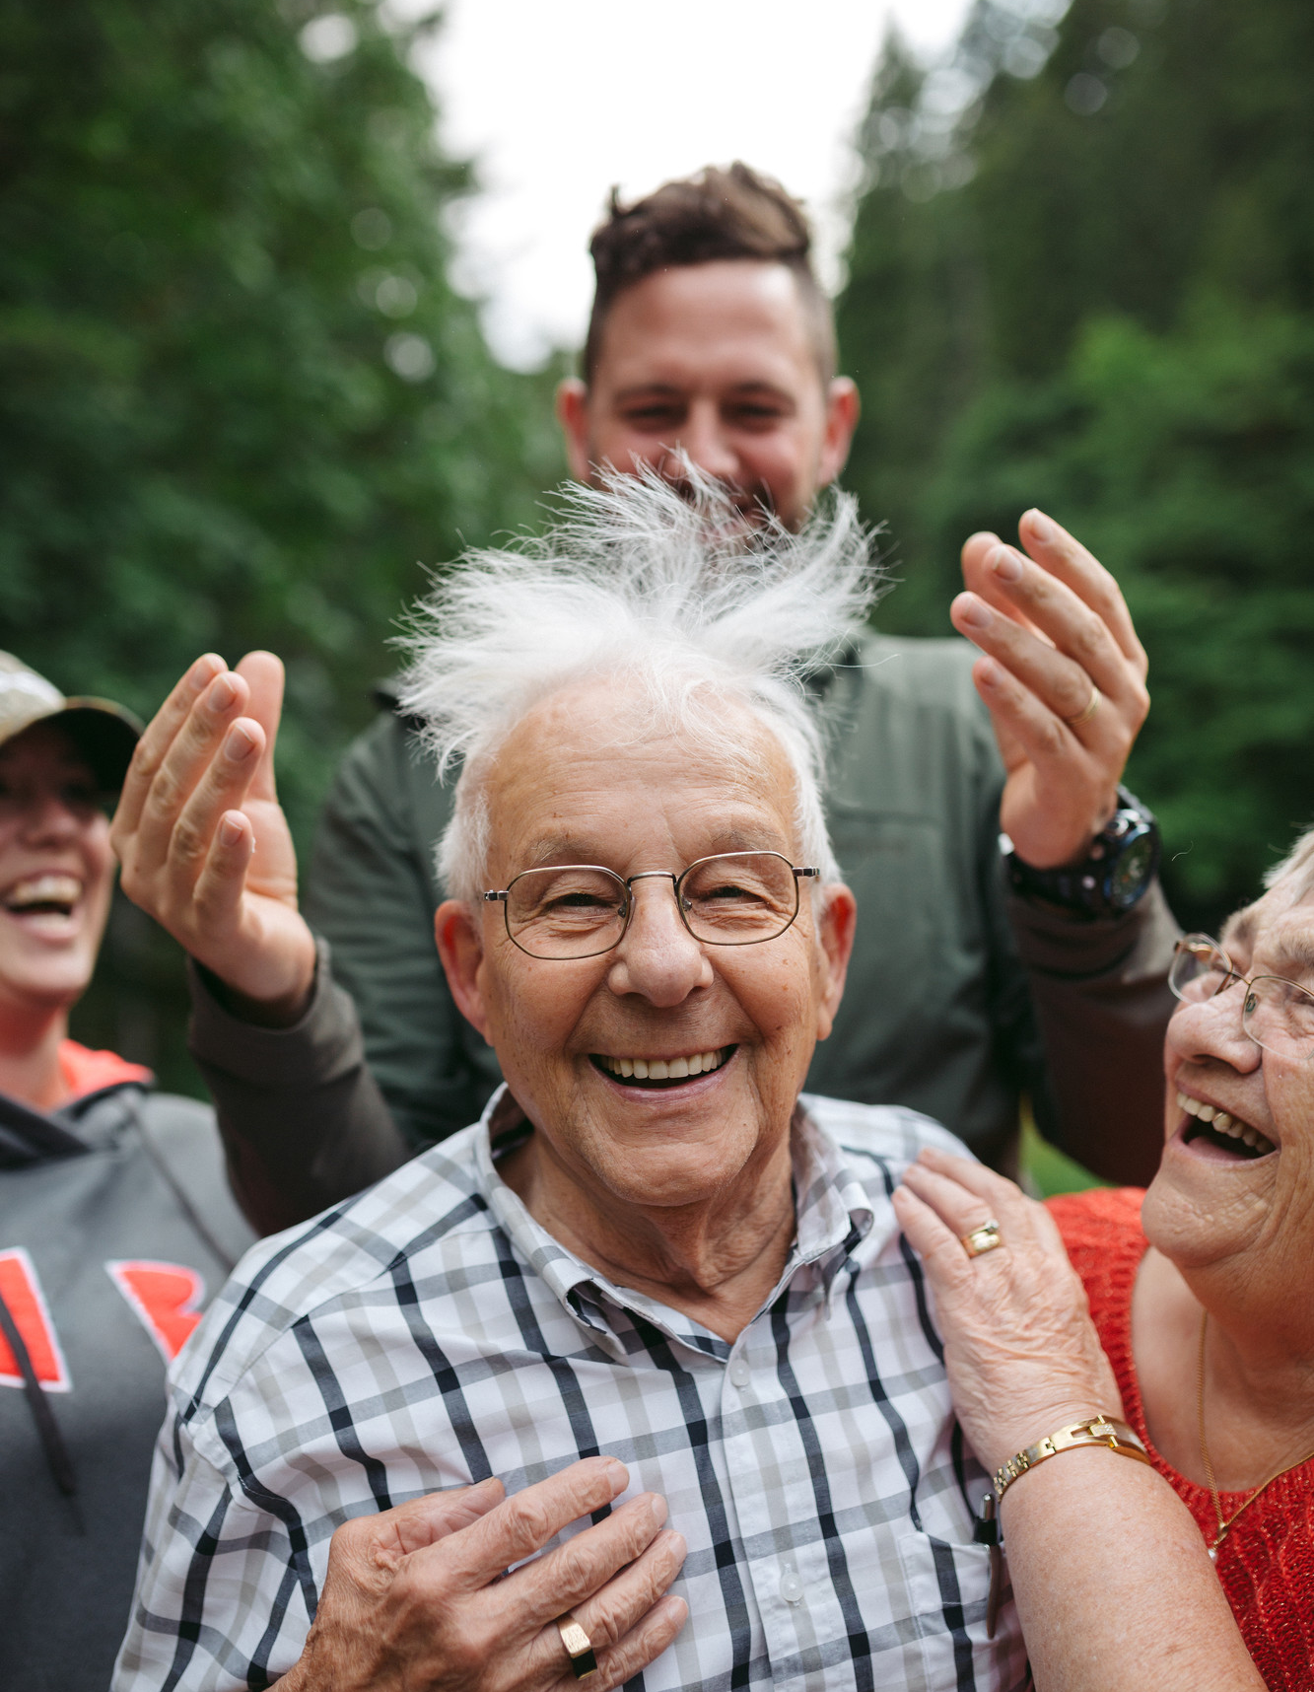
Our aim
Our vision is a society where everybody enjoys a good later life
By 2040, we want more people in later life to be in good health, financially secure, to have social connections and feel their lives are meaningful and purposeful
To achieve real and significant impact, we will focus on where we can make the biggest difference – those approaching later life, a life stage between mid-life and later life
2
Notes:
We are an independent charitable foundation..
Our vision is a society where everybody enjoys a good later life
By 2040, we want more people in later life to be in good health, financially secure, to have social connections and feel their lives are meaningful and purposeful
To achieve real and significant impact, we will focus on where we can make the biggest difference – those approaching later life, a life stage between mid-life and later life

Slide 3
Our population
Projected demographic change over the next 15 years
A child born today has a 50% chance of living to 100
By 2032, ONS predicts a 26% increase in people aged over 65 and a 55% increase in those aged over 85
Source: ONS Table A2-1, Principal projection - UK population in age groups, 2017
3
Notes:
As im sure we are all aware, ther has been a dramatic age shift in our population. ONS predicts a 26% increase in people aged over 65 by 2032
And at centre for ageing better we know a key part of a healthy long life is an accessible, suitable and safe home.

Slide 4
The role of housing

Slide 5
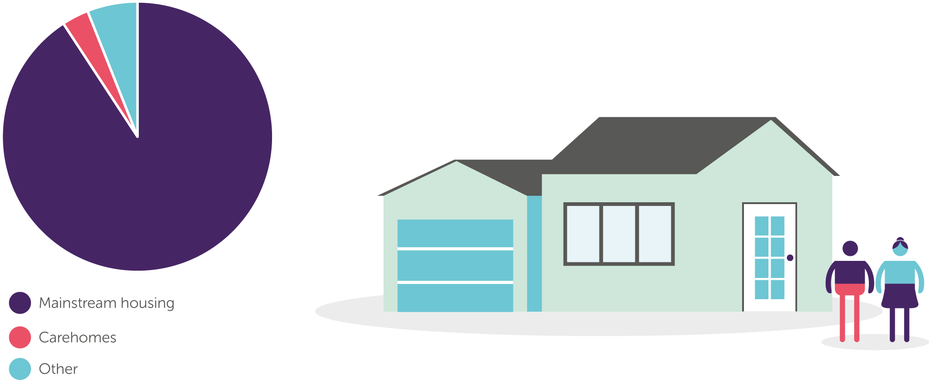
More than 90% of older people live in mainstream housing
80% of the homes we need by 2050 are already built*
*Source: Boardman et al, 2005
Notes:
We ll know the assumptions of older people living in retirement homes and things alike paints a very small picture, when actually 90& of older people live in maninstream housing. A majority of these homes are not suitable for older people and this is unlikely to change without intervention as 80% of the homes we needs by 2050 are already built.
77% of older people are also owner-occupiers which can make them harder to reach whether that be for help with adaptations or home renovations as a result of non-decency
Whilst I know there may be questions surrounding the rise in PRS
However, whilst the proportion of households aged over 64 who are privately renting will more than double by 204, this will still only sit at 12%.
Now I am not saying this should be ignored I am simply stressing the fact a large majority of people will still be owner occupiers

Slide 6
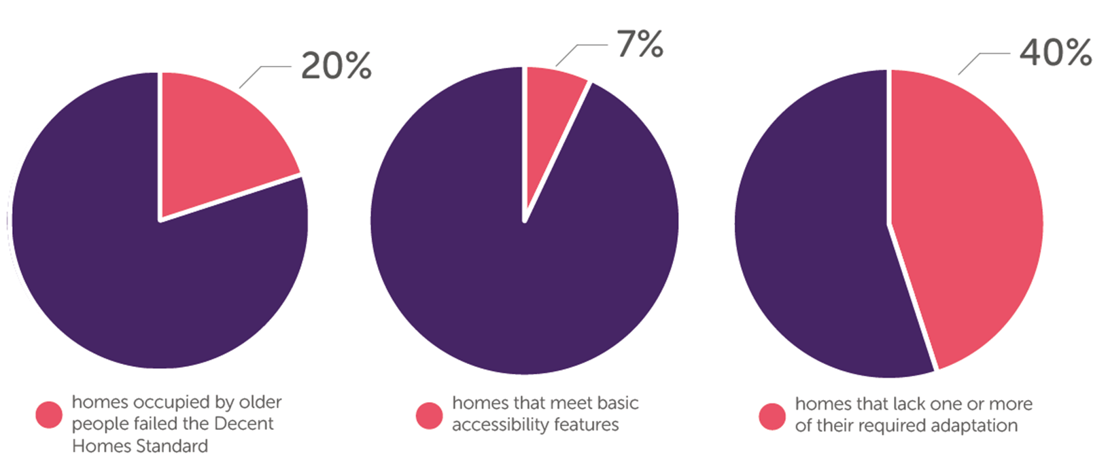
Current UK housing stock is not suitable, adaptable or accessible for people in later life
Only 7% of homes meet basic accessibility features*
*Source: DCLG (2016), English housing survey 2014 to 2015: adaptations and accessibility of homes report

Slide 7
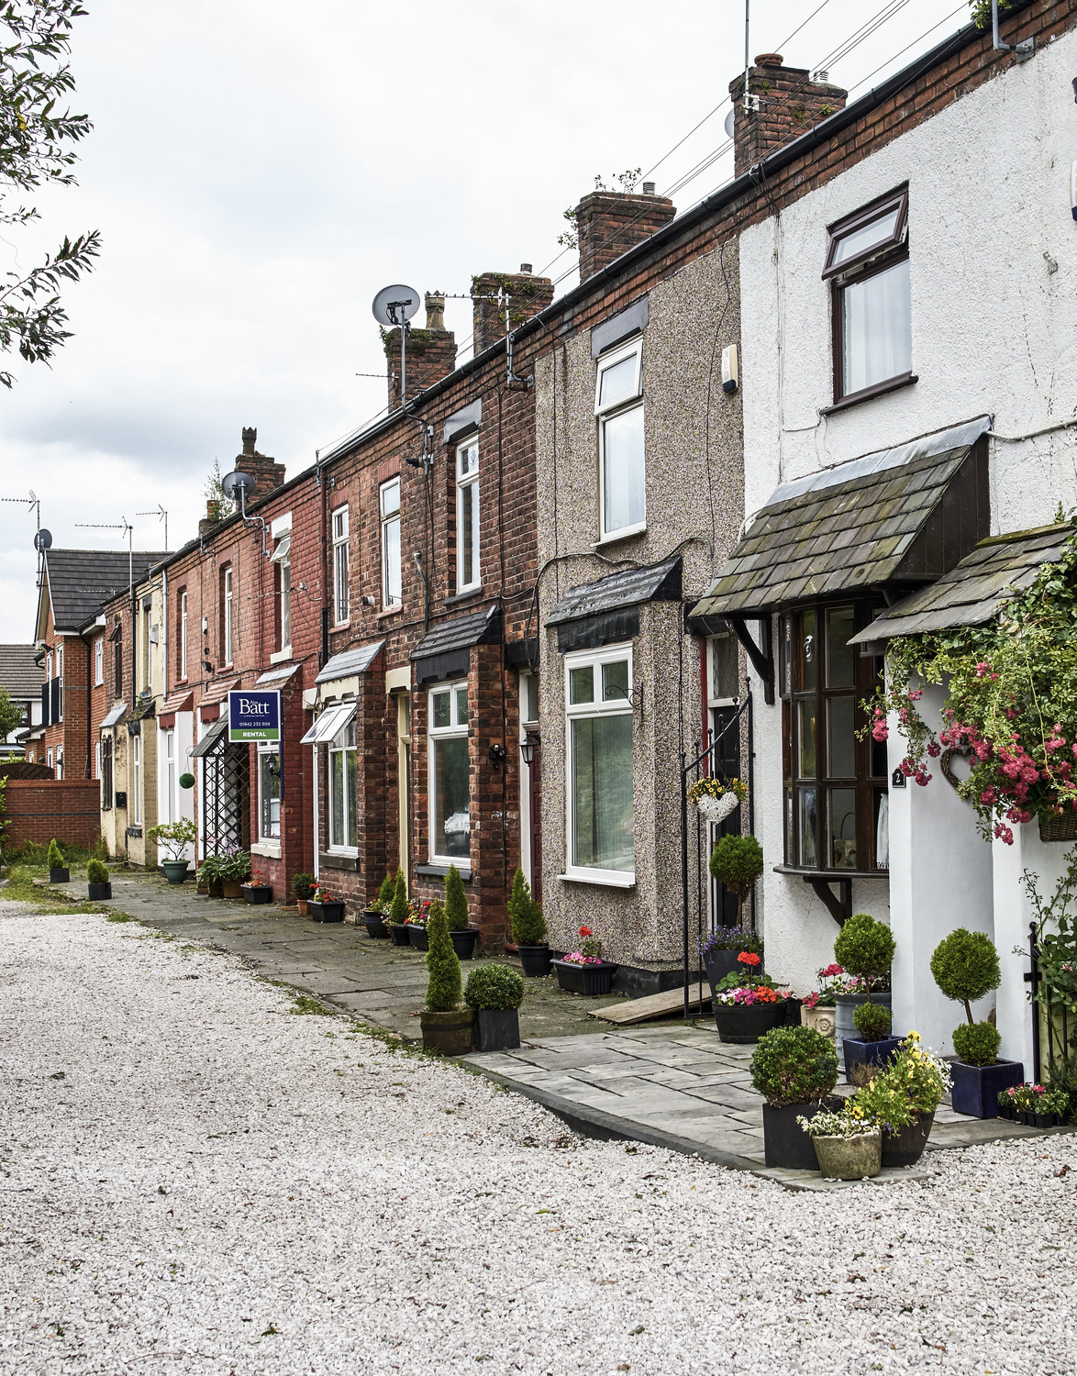
The goal
Our aim is for more people to live in safe and accessible homes by:​
Improving the condition and accessibility of existing housing ​
Increasing the diversity of suitable homes for people approaching later life who choose to move​
Making information and advice more easily available to help people approaching later life make good housing choices
Our goal is that by 2030 there will be one million fewer homes defined as hazardous and half of all new homes will meet accessibility standards
7
Notes:
Our new strategy

Slide 8
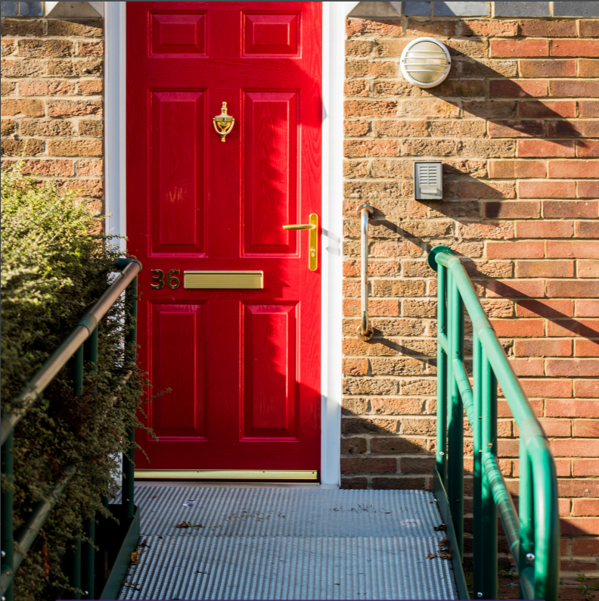
Ageing Better’s initial work on adaptations
Evidence review
Primary Research
Call for Practice
Notes:
Reminder about what we have done to date on existing homes – focusing on aids and adaptations
The review:
The overall aim was to synthesise the published evidence, and quality of that evidence, for how home adaptations can contribute to improving later life and to attempt to model the potential cost saving implications, to make recommendations for national policy, local service design and practice. .
Primary research:
The Centre for Ageing Better commissioned qualitative research to understand motivations for and barriers to acquiring home adaptations and their impact on quality of life. The research was led by a team from Northumbria University, in partnership with Newcastle City Council, North Tyneside Council, Newcastle University and Elders Council of Newcastle.
Call to practice:
We commissioned Care & Repair England to carry out a ‘call for practice’ to identify practical examples of local areas that are organising and delivering adaptations effectively. This report identifies the elements of high-quality and innovative practice in the provision of home adaptations for older people.
One of the things to come out of this initital work also the presence of non-decent homes and linking effect this has with the presence of adaptations
I also just wnt to say all the work I have just described is up on our website

Slide 9
Non-Decent Homes

Slide 10
So what is a ‘Decent Home’?
Developed in early 2000s, defined in 2004 (Housing Act/2006 amendments)
It meets the current statutory minimum for housing (HHSRS*)
It is in a reasonable state of repair
It has reasonably modern facilities and services
It provides a reasonable degree of thermal comfort
* Specific hazards (29) that pose a threat to occupants’ health or safety
Notes:
It meets the current statutory minimum for housing; dwellings which fail to this criterion are those containing one or more hazards as assessed as serious (Category 1) under the HHSRS.
It is in a reasonable state of repair; dwellings which fail to meet this criterion are those where one or more of the key building components are old, or because of their condition need replacing or major repair
It has reasonably modern facilities and services; dwellings which fail to meet this criterion are those which lack three or more of the following:
a reasonably modern kitchen
a kitchen with adequate space and layout
a reasonably modern bathroom
an appropriately located bathroom and WC
adequate insulation against external noise
adequate size and layout of common areas for blocks and flats
It provides a reasonable degree of thermal comfort; this criterion requires dwellings to have both effective insulation and efficient heating.

Slide 11
What is the Evidence?
Notes:
At this time the evidence is severely lacking
Therefore we have partnered with Care and Repair England to try and build on this evidence.
This is very much an ongoing project in its early stages, we don’t even still know how to solve this problem. However at this time we are:
Starting on the development the framework:
Data analysis – BRE commissioned to mine the EHS data re: decent homes
Stakeholder engagement – North plus South events in September 19, Older People’s Housing Champions discussions etc.
Outputs - C&RE produces reports – internal then joint report launched Lords Dec 19

Slide 12
The Facts so far…
33.8% of those living in Non-Decent Homes have long term illness or disability
2 million older households are living in Non-Decent Homes
78% of these Non-Decent Homes are lived in by older people are owner occupied
*Source: BRE analysis of the 2017 English Housing Survey (2019)
Notes:
4.3 million homes non decent in UK
2 million of these occupied by over 55s
As I said earlier 77% of older people are owner occupiers – as a tenure they are largely ignored in the media and policy. From this stat you can see as the largest percentage of non-decent homes are owner occupied – therefore this problem needs to be addressed
11% social rented
11 private rented
Incidence of non-decency is highest for over 75s homeowners

Slide 13
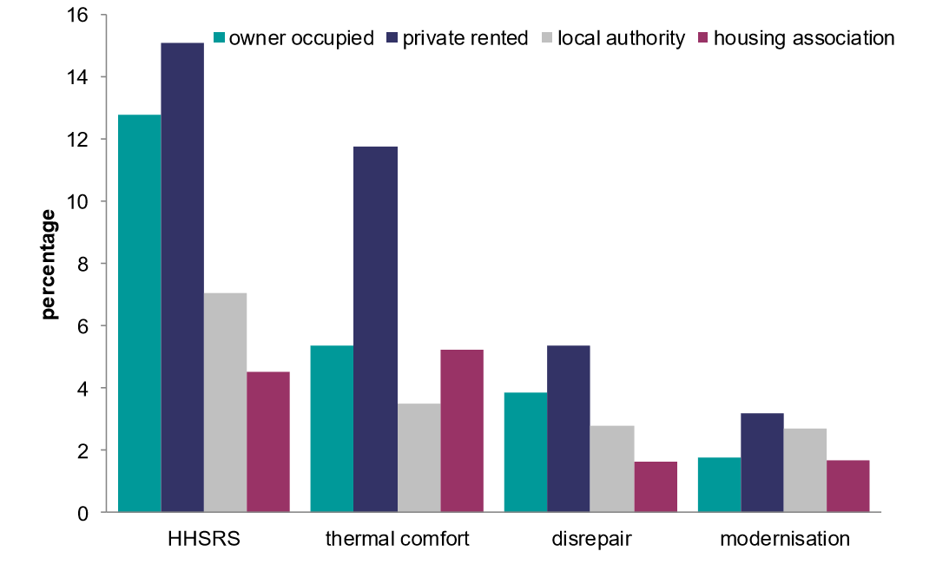
Reason for failing the Decent Homes Standard, 2017
Source: English Housing Survey 2017
Notes:
The main reason for properties failing the Decent Homes standard is the presence of a Category 1
hazard. The second most common failure is thermal comfort.
Defined by the Housing, Health and Safety Rating System (HHSRS) a Category 1 hazard presents an immediate risk to the health or safety of the housing occupant(s).
In 2017, 2.5 million homes (11% of all households) had a HHSRS Category 1 hazard.
The two most common Category 1 hazards are falls risk and excess cold (c. 80% of all Cat 1 hazards), both of which have a disproportionate impact on older occupants' health.
There are 1.1 million older households (HRP 55yrs+) living in a non-decent home with a Category 1 hazard (44% of all homes with a Cat 1 hazard)

Slide 14
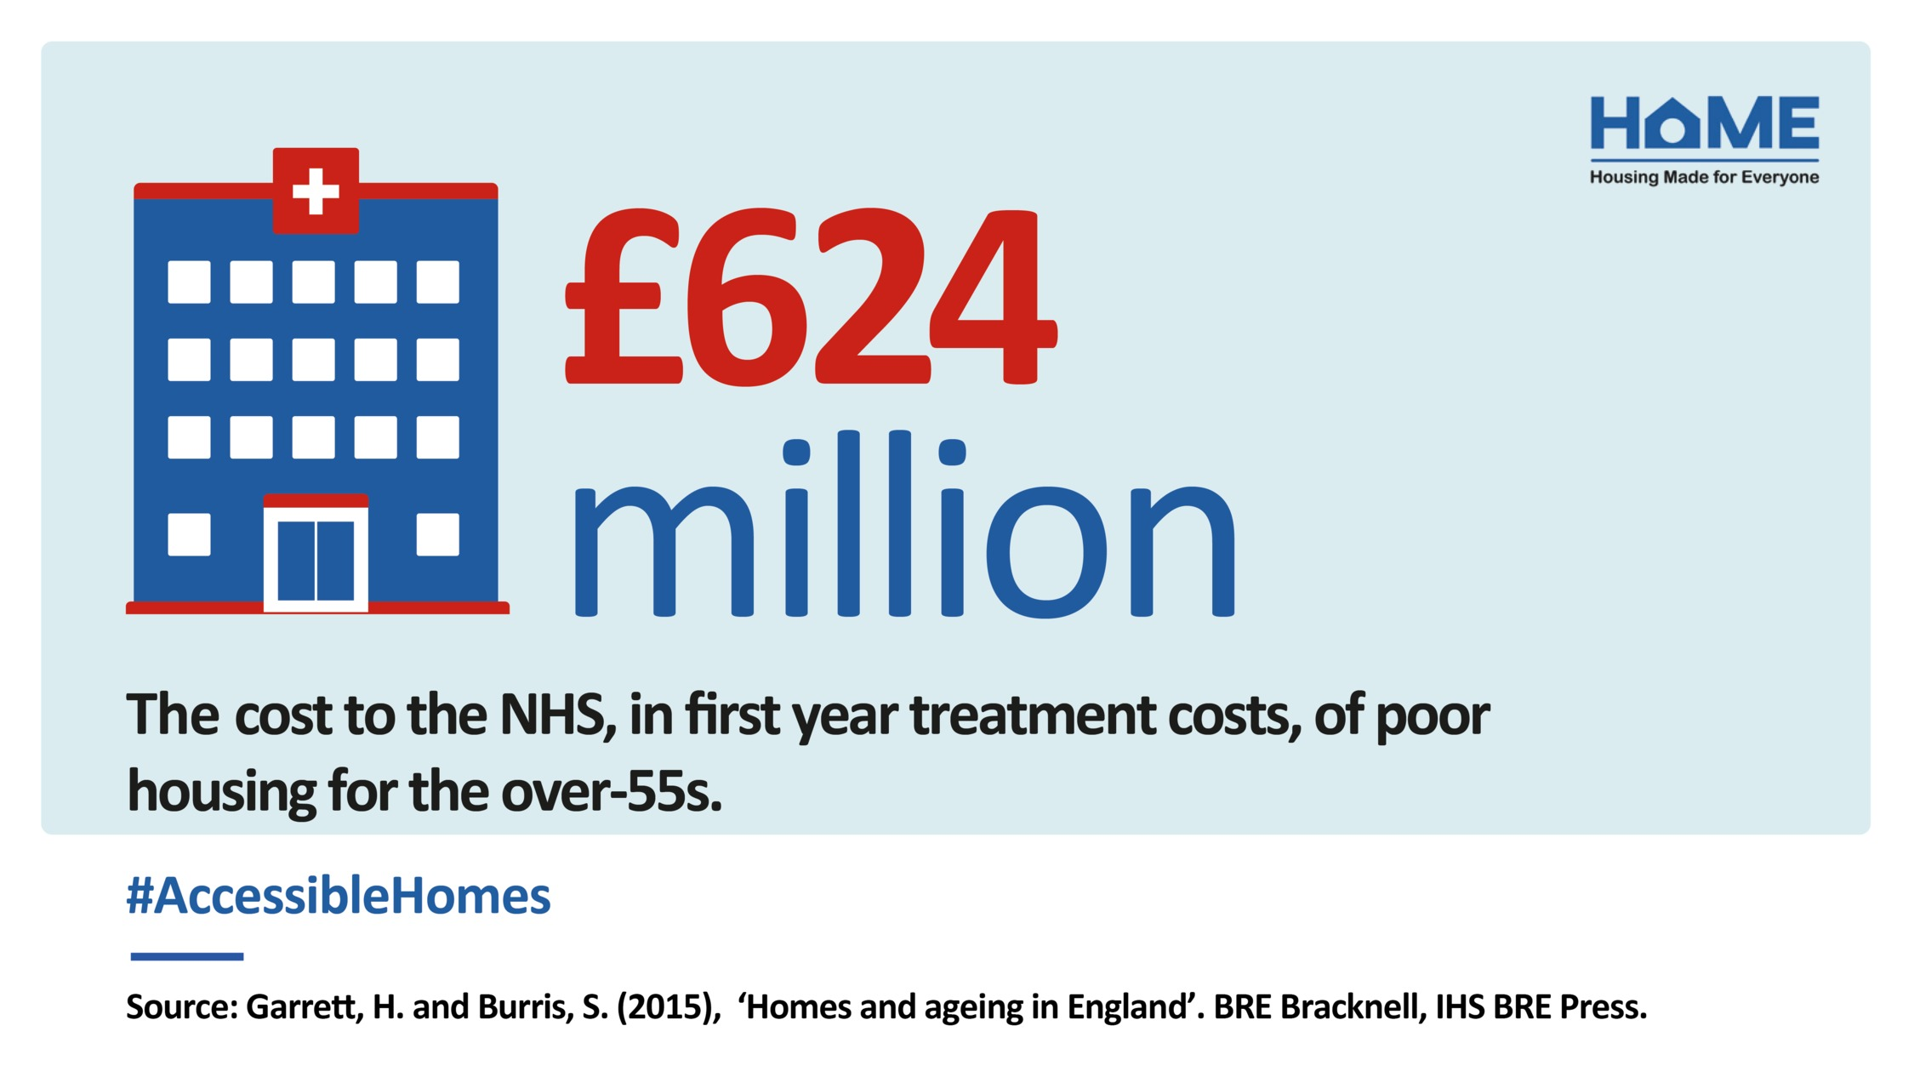
Many of the common chronic health conditions experienced by older people have a causal link to, and/or are exacerbated by particular housing conditions!
The Cost
to Health
Cost of poor housing to the NHS = £1.4 billion pa*
*These amounts are based on conservative modelling by BRE using NHS data and HHSRS data from the EHS (Roys et al, Nicol et al 2010(.
Notes:
Whilst the most important reason for suitable and safe housing for people is to ensure the individual can live an independent and happy life we must also look at the cost to not only the individuals health but the cost of this to the NHS
Improved housing reduces health risks, prevent falls and support safe, timely hospital discharge, all of which impact on NHS costs.
Many of the common chronic health conditions experienced by older people have a causal link to, and/or are exacerbated by particular housing conditions. These include heart disease, stroke, respiratory conditions, mental health, arthritis and rheumatism. 1

Slide 15
Millie Brown
Millie.brown@ageing-better.org.uk
Centre for Ageing Better
Angel Building, Level 3
407 St John Street, London, EC1V 4AD
020 3829 0113
www.ageing-better.org.uk
Registered Company Number: 8838490 & Charity Registration Number: 1160741

